Slide 1
Microsoft Powerpoint-The Basics

Slide 2
Basic PowerPoint Orientation
Across the top are tabs
Tabs open ribbons
Ribbons contain groups
Some groups have a launch button-gives more options
Along the left of the screen is the thumbnail ribbon
Contains overall view of each slide

Slide 3
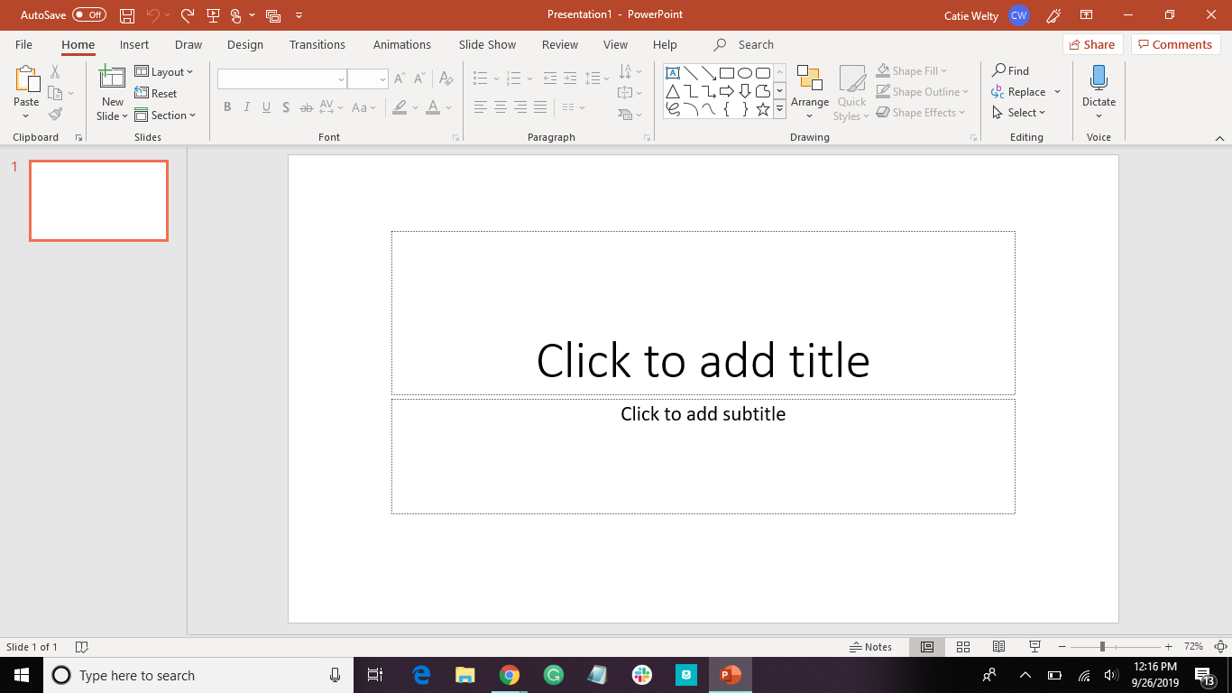
Tabs
Ribbon
Group
Launch Button

Slide 4
Let’s Change the Design
Design Tab
Click on double arrow to see all options
Hover over the design to preview it on the slides
Click to select

Slide 5
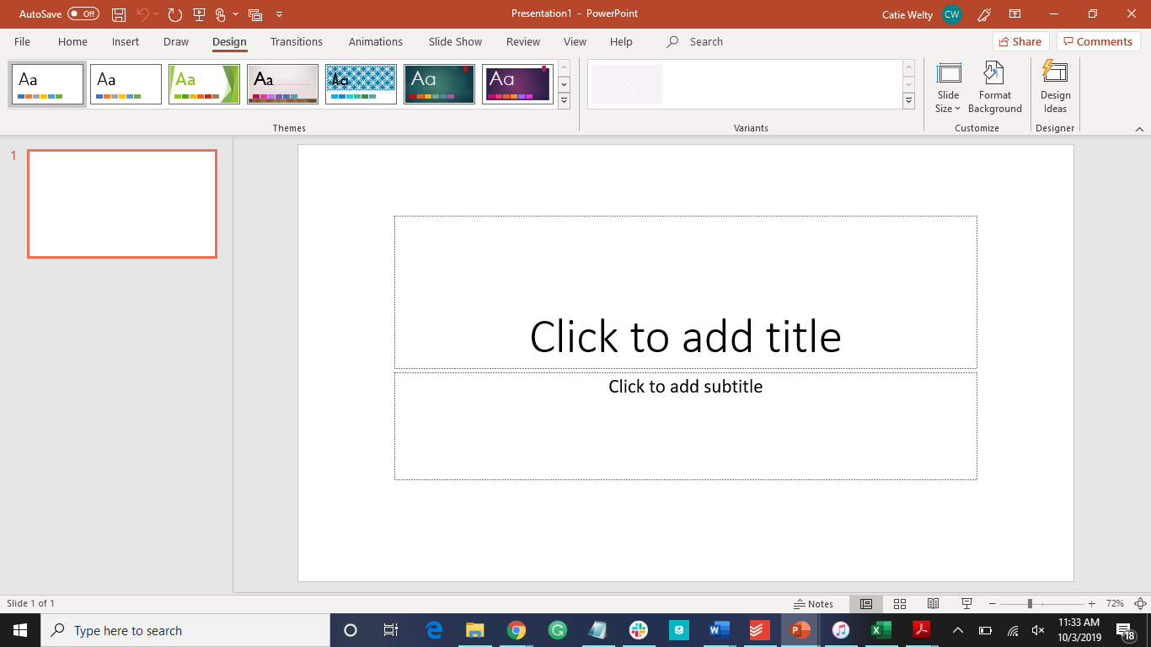
Click here

Slide 6
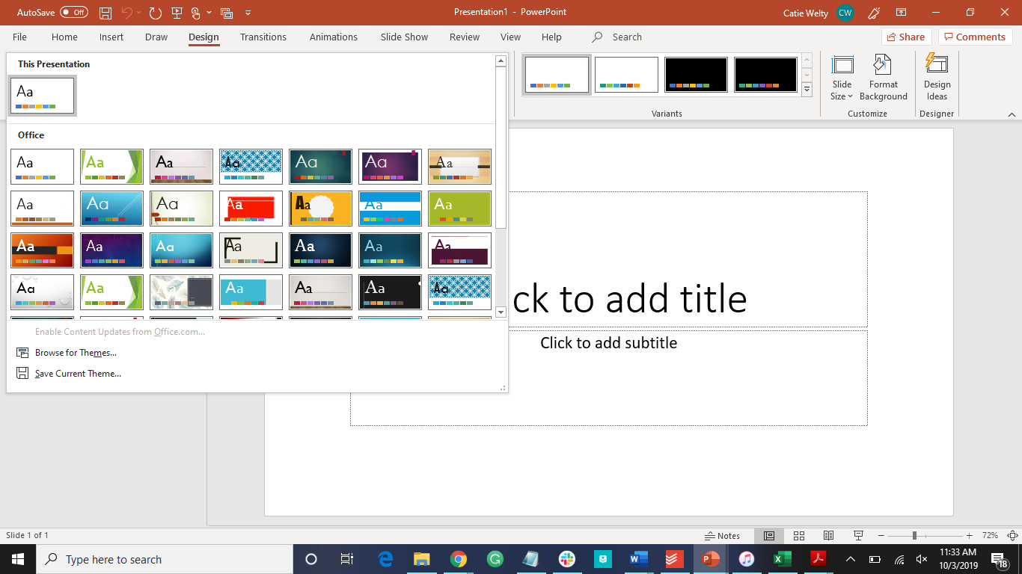
Scroll to choose design

Slide 7
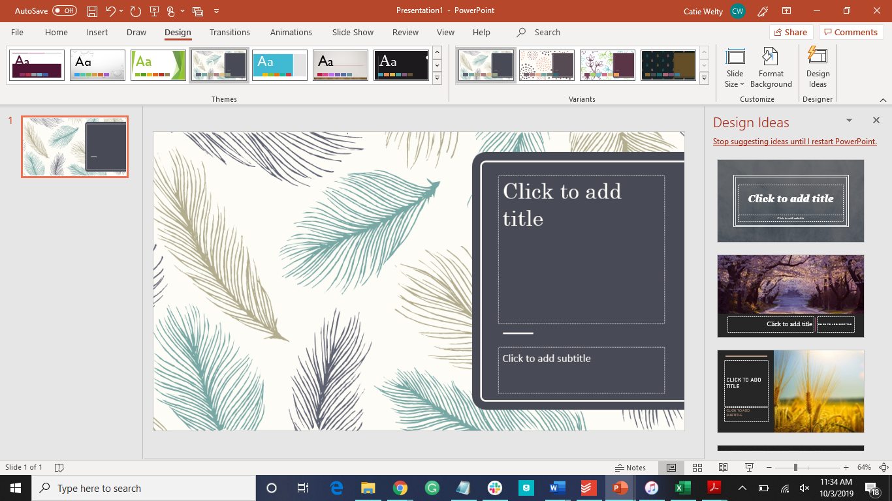
More design ideas

Slide 8
How To Add a New Slide
Two options:
New slide button in home tab
Click on the down arrow to select slide layouts
Right click in thumbnail ribbon

Slide 9
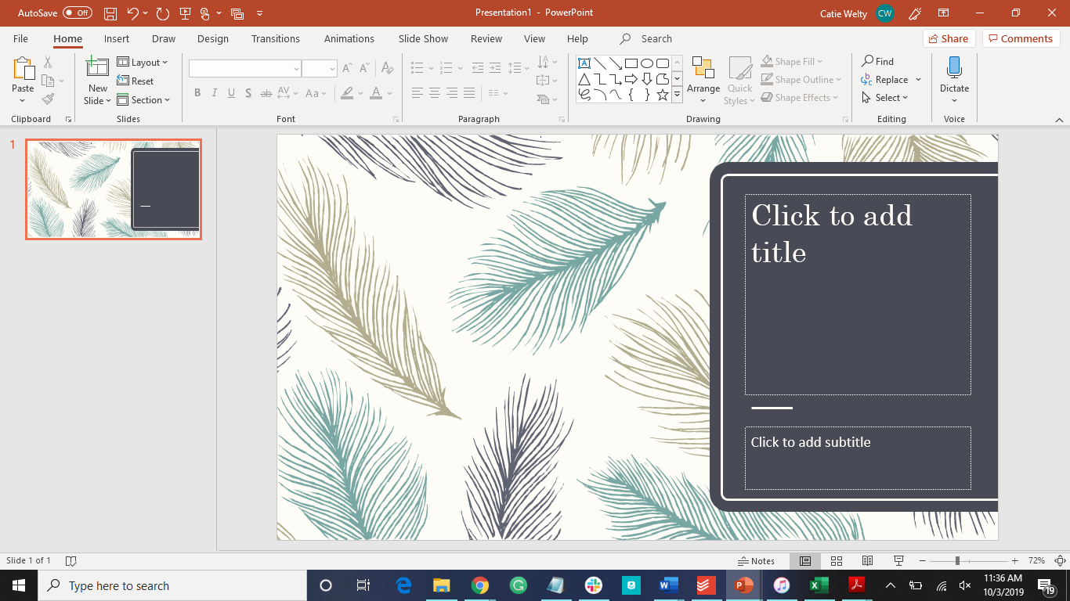
You can click this to add the standard title and content slide….

Slide 10
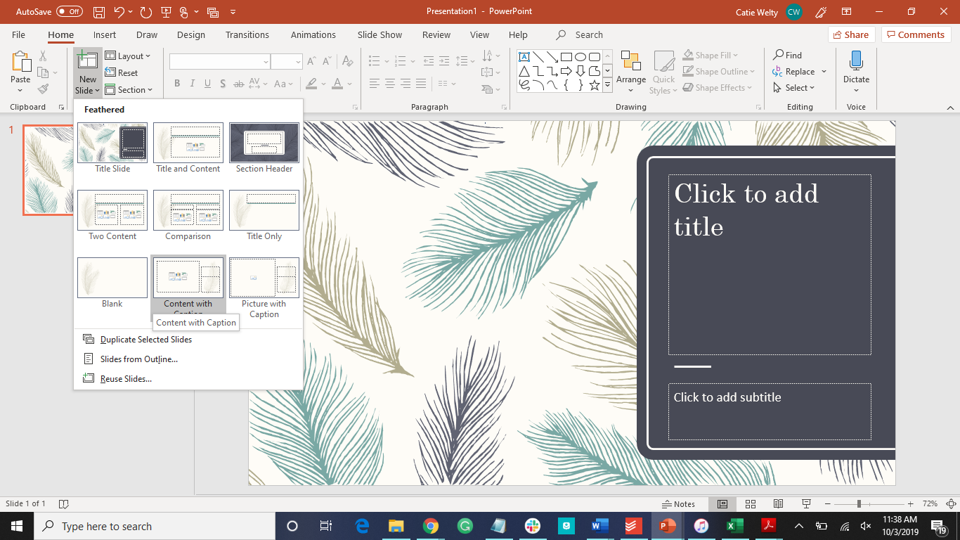
...or you can click on the arrow to see all the options

Slide 11
How to Add Ideas
Enter to get a new line
Enter again or backspace to remove bullet
Can also have text boxes instead of bullet points

Slide 12
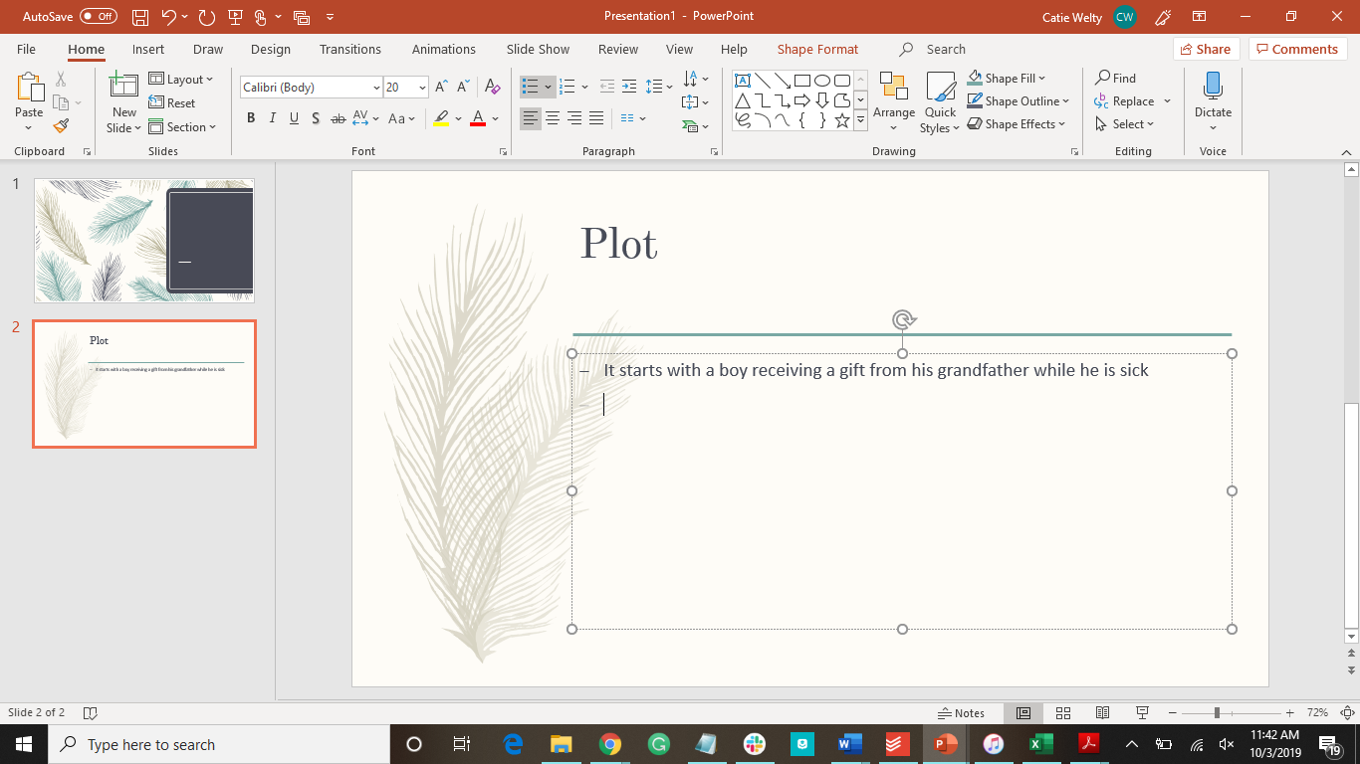
Here you can faintly see the next bullet

Slide 13
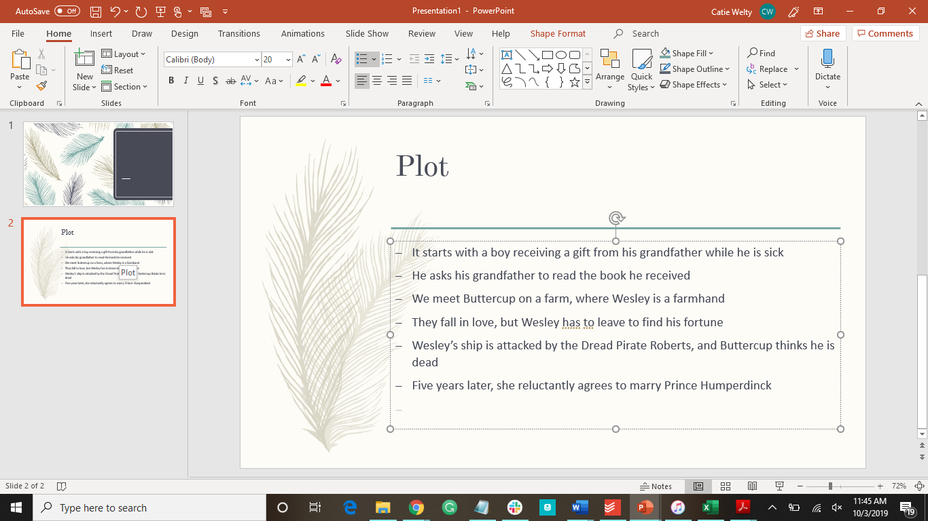
Here is a complete slide. Can you guess what I’m describing?

Slide 14
How To Add an Image
Click in the Insert tab
Look in the Images group
Choose image type
Pictures
Choose a picture from your computer
Online Pictures
Choose a picture from the internet
**first time may be slow***
Resize the images by the handles

Slide 15
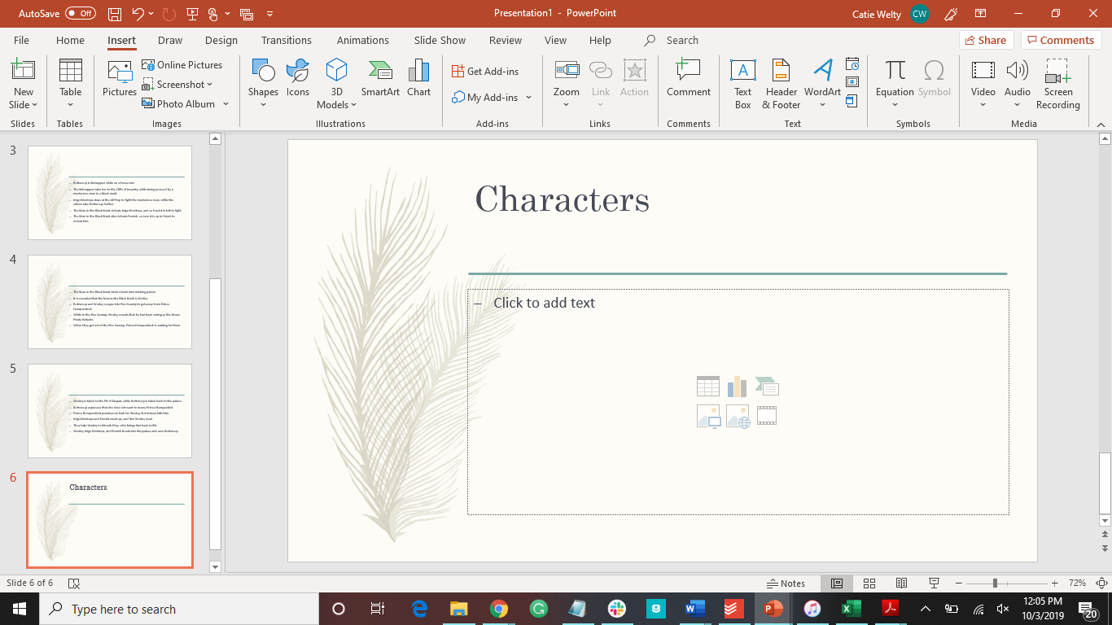
Here is where you can insert images. Click on picture to look on your computer…

Slide 16
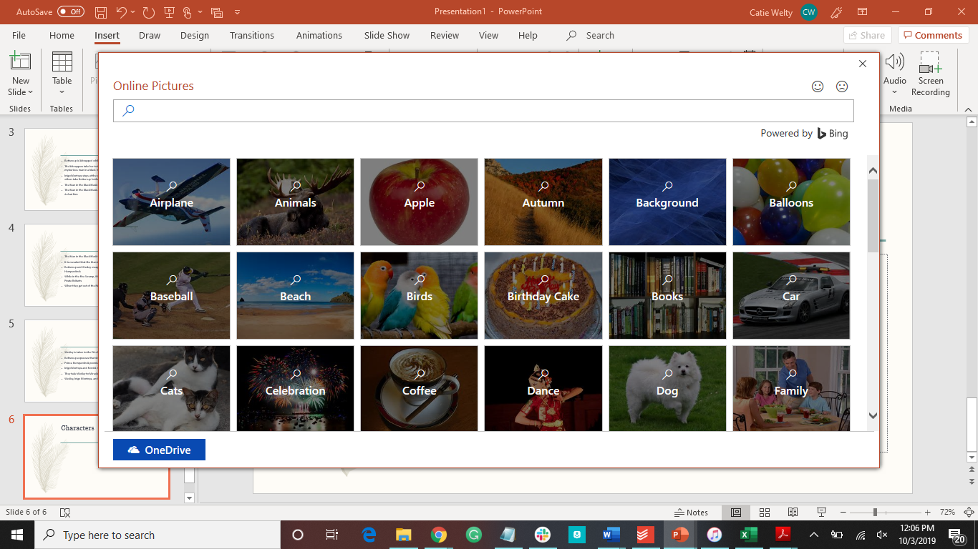
...or click on Online Pictures to search the internet

Slide 17
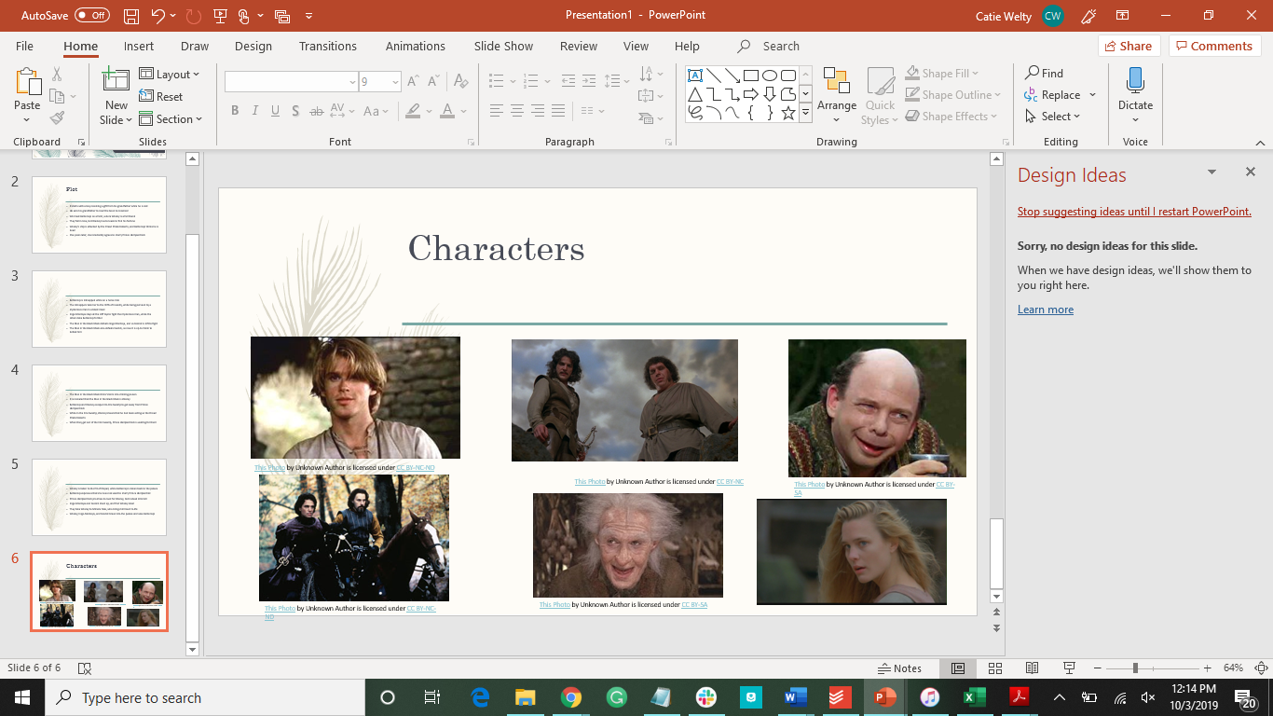
Slides that have less than five images will pop up Design Ideas, where PowerPoint will show different ways to layout the elements.
Do you know what I’m describing now?

Slide 18
How to Edit Images
Remove a background from an image:
Click on image
Click on format
Color
Set transparent color

Slide 19
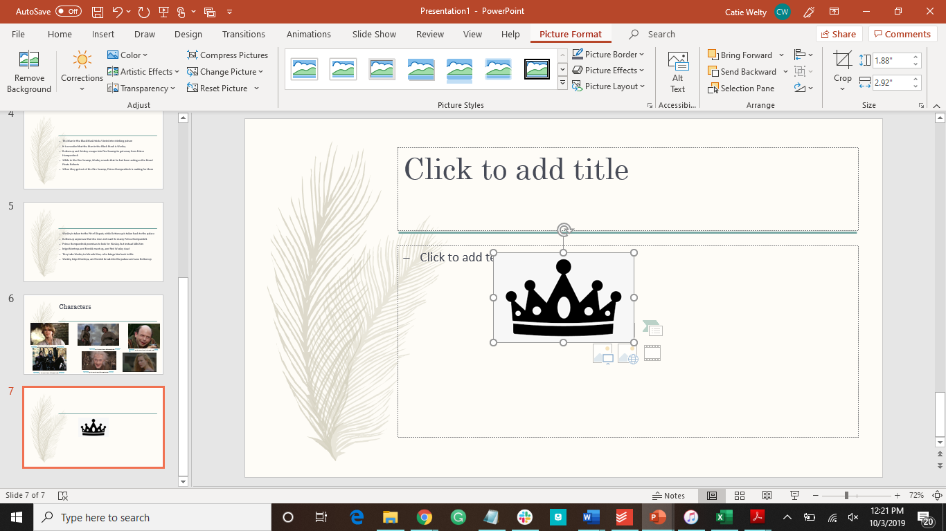
Click here...

Slide 20
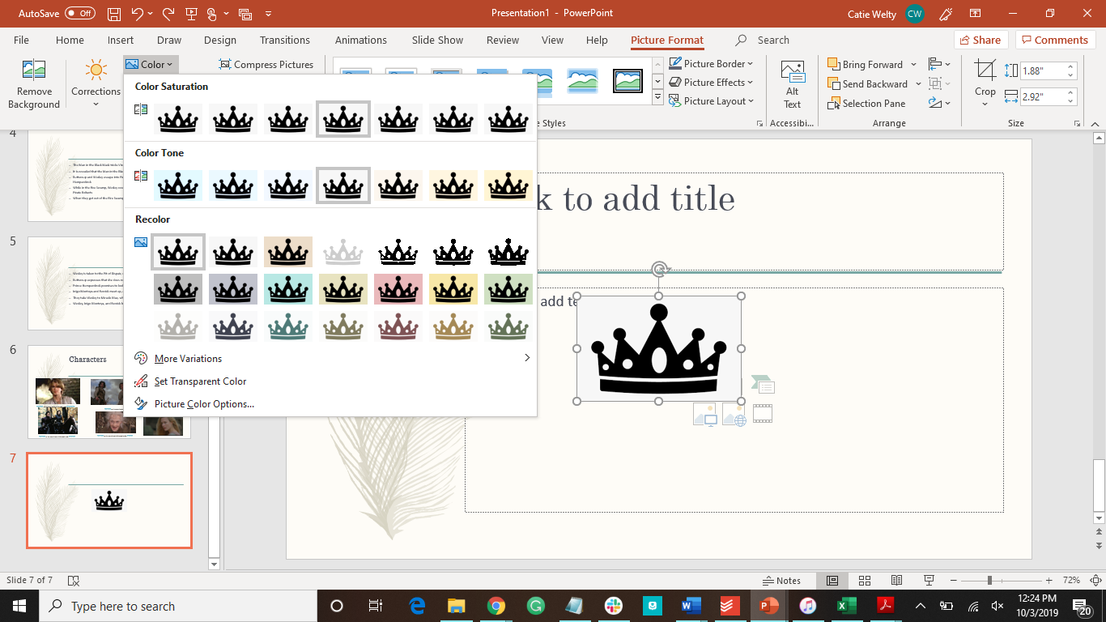
...then here...

Slide 21
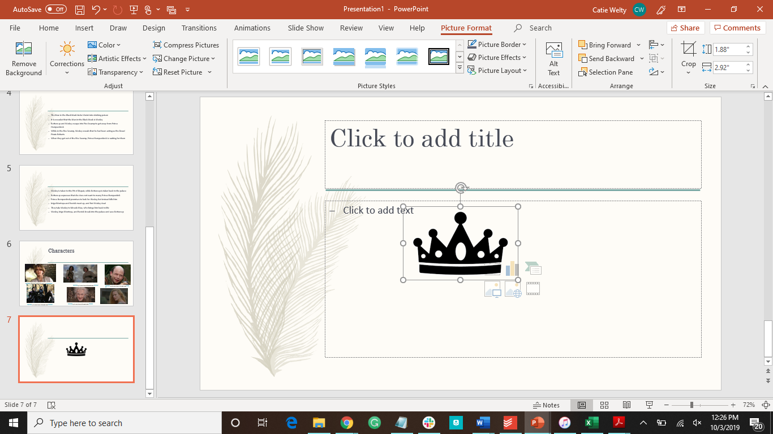
...and then click on the background to make everything white transparent.

Slide 22
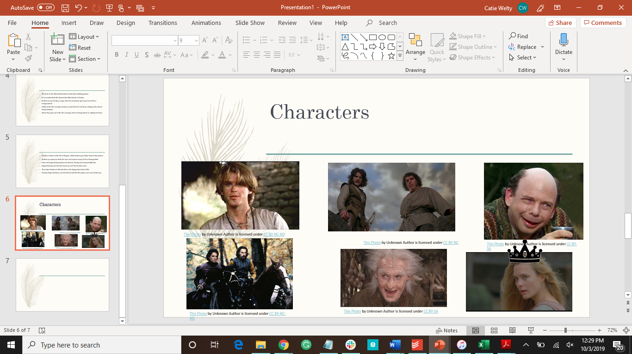
Copy and paste to move the image

Slide 23
How to Add Animations
Click on what you want to animate
Go to the animation tab
Click on the double down arrow to see all the options
Choose which one you would like to use

Slide 24
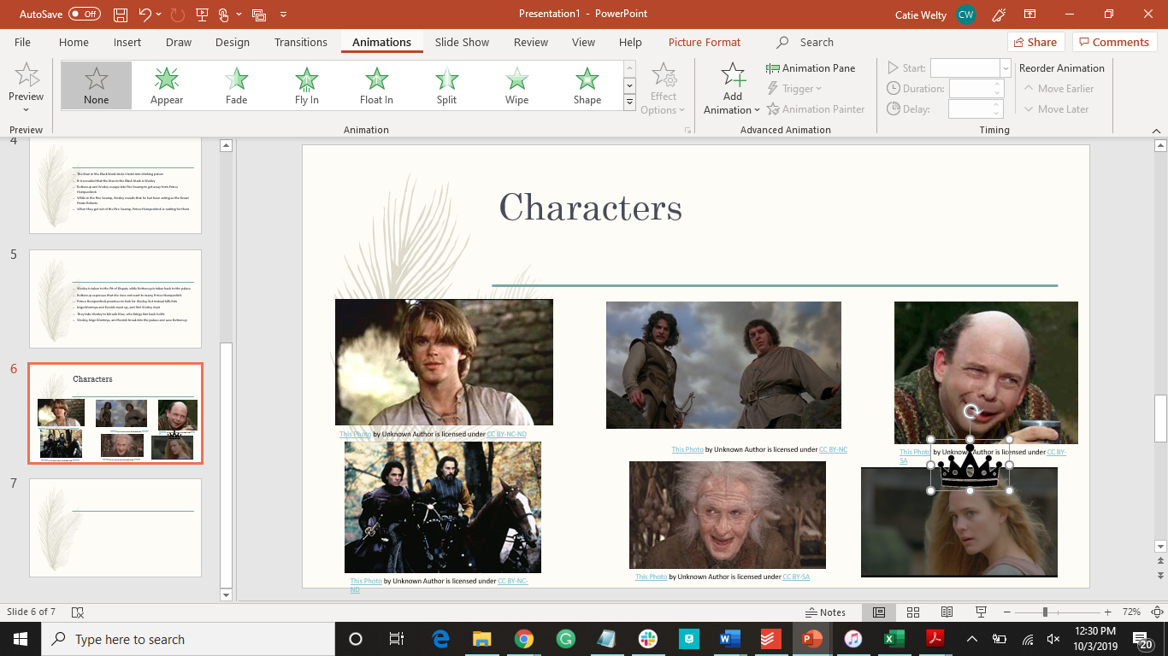
Click here to see all the options

Slide 25
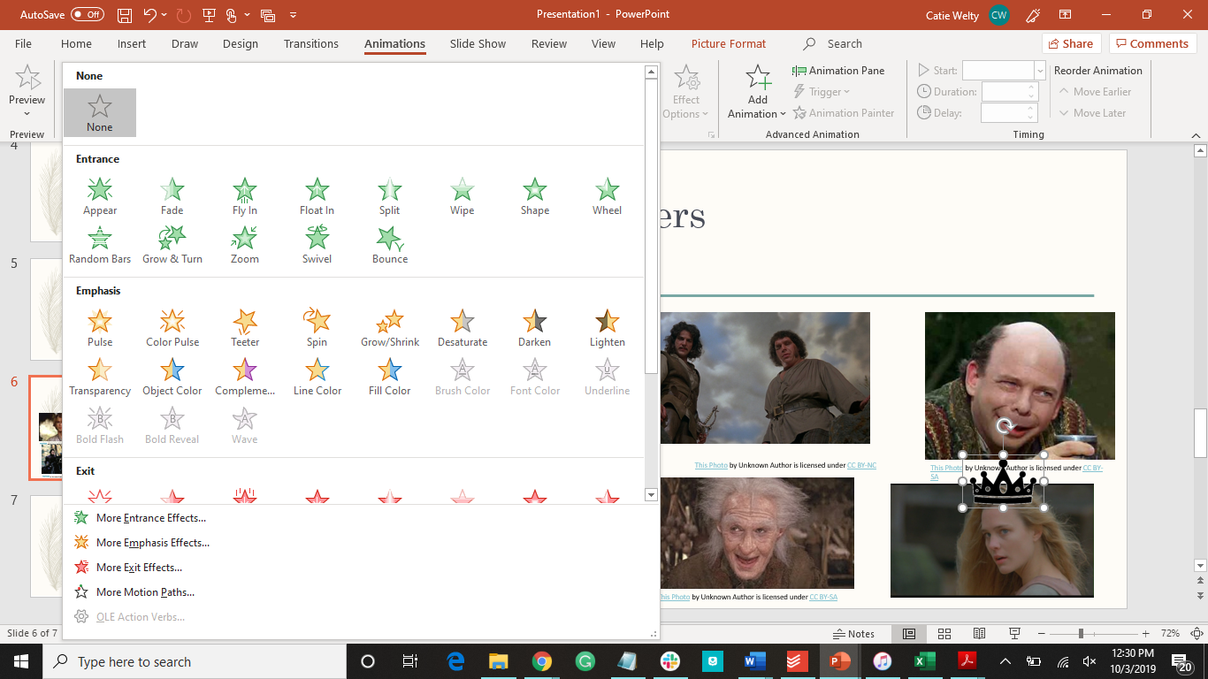
Choose which you would like

Slide 26
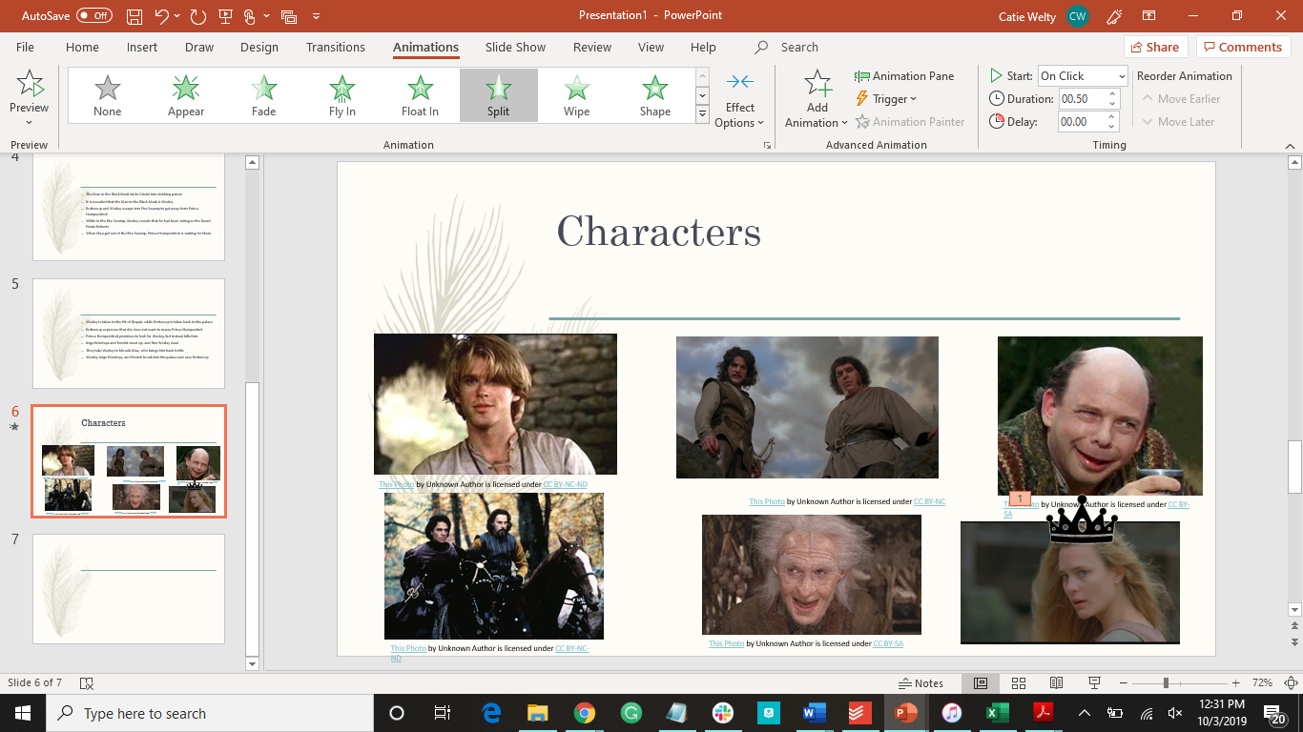
A number will appear indicating the order of the animations

Slide 27
How to Add Videos
Three video formats you can use:
One that is already on your computer
Using a video embed code

Slide 28
Insert a Video From Computer
Insert tab
Insert Video from PC

Slide 29
Insert a Video with an Embed Code
Find the video you would like to add
Find the embed code
Copy and paste the embed code

Slide 30
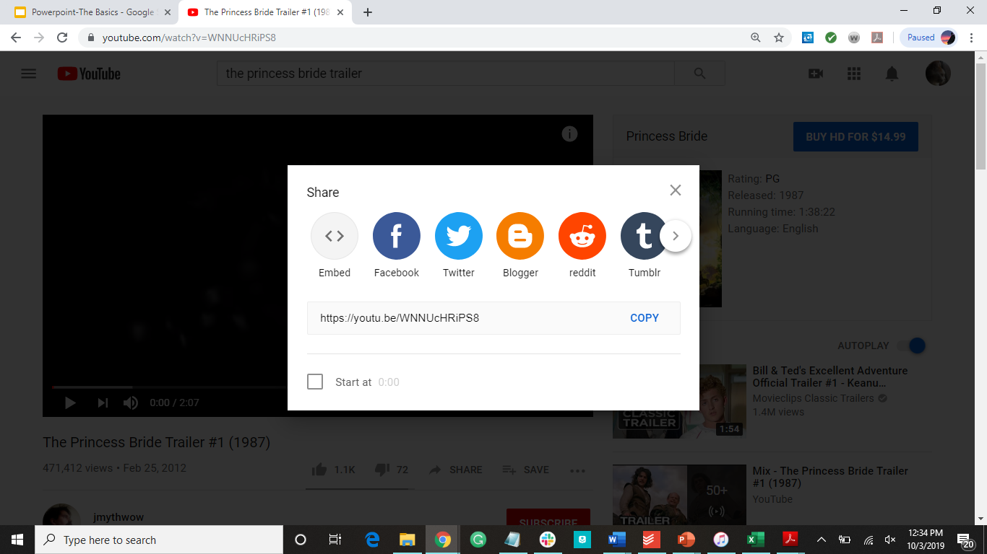

Slide 31
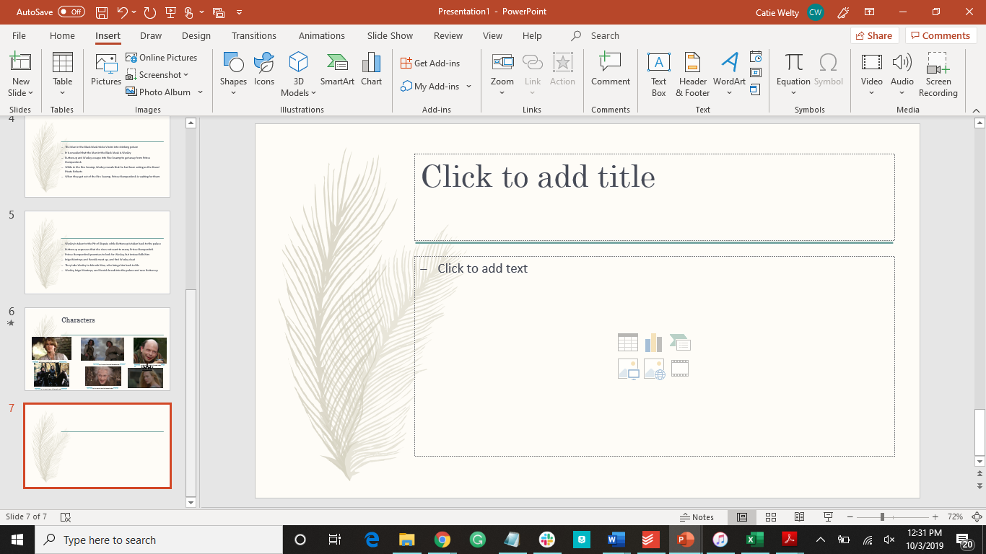
Click here...

Slide 32
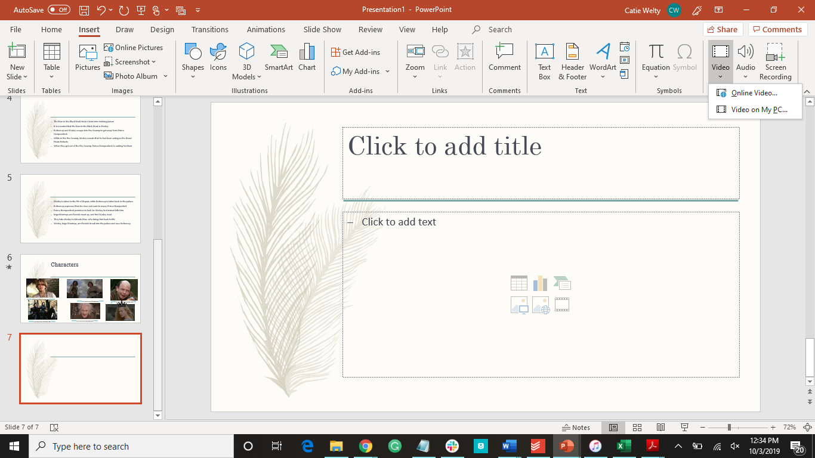
...then choose where the video is

Slide 33
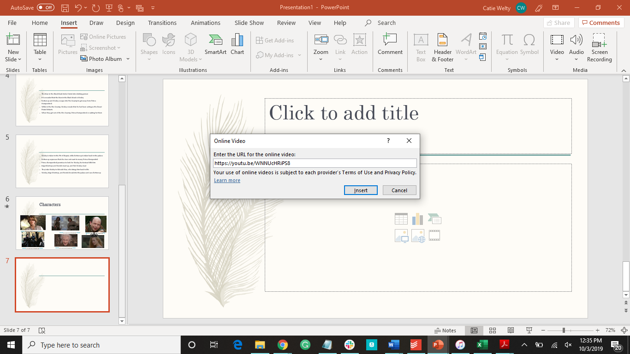
Choose Online Video to input an imbed code

Slide 34
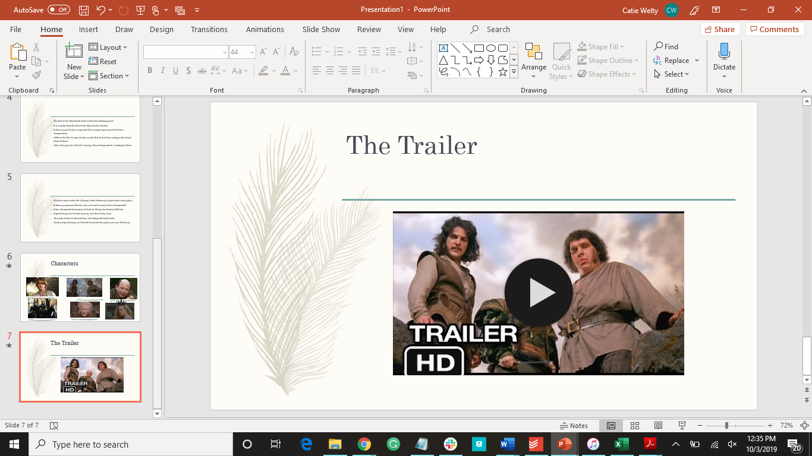
Were you right with what I was describing?

Slide 35
How to Add a Timer
This is 5 seconds long
Time’s Up!!!!
1
2
3
4
5
Insert text box
Type the number you want to start with in that text box
Format the text box to how you want it
Copy and paste the text box and change the number until you have all the numbers you want
Add exit animation to all of the text boxes in the order of the numbers
Give a one second delay, and have each text box after start automatically
Place the text boxes where you would like them

Slide 36
How to Add a Timer (version 2)
Choose a shape for the timer bar
format->animations->fly out->effect options->fly out to the left
Set duration to how long you want the timer to be
This is 5 seconds long

Slide 37
How to Add a Sound to a Timer
Insert->audio
Choose the sound you would like
Animation pane->start after previous

Slide 38
How to Navigate the PowerPoint While Presenting
spacebar=next slide
enter=next slide
right arrow/down arrow=next slide
left arrow/up arrow=previous slide

Slide 39
Helpful Shortcuts
ctrl+I | italicize
ctrl+B | bold
ctrl+U | underline
ctrl+C | copy
ctrl+X | cut
ctrl+Z | undo
ctrl+V | paste
ctrl+F | find

Slide 40
Have more questions?
Email us at ccla@doane.edu or come visit us in Communications 188D from 9am to 5pm.
You can also visit our website at https://www.doane.edu/ccla

Slide 41
Resources
[Technology for Teachers and Students]. (2017, Sep 18). The Beginner’s Guide to Microsoft PowerPoint. [Video file]. Retrieved from https://www.youtube.com/watch?v=XF34-Wu6qWU&list=PL_iwD7O7FG7g4pUk1A5eeRG9MWqVe7FAX&index=2&t=0s
[Technology for Teachers and Students]. (2018, Jan 31). Intermediate PowerPoint-Adding Videos to Presentations. [Video file]. Retrieved from https://www.youtube.com/watch?v=zLFfZKo9NRo&list=PL_iwD7O7FG7g4pUk1A5eeRG9MWqVe7FAX&index=2
[Technology for Teachers and Students]. (2014, Jun 30). Remove Background from Images in PowerPoint tutorial. [Video file]. Retrieved from https://www.youtube.com/watch?v=U6Zck_5__0g&list=PL_iwD7O7FG7g4pUk1A5eeRG9MWqVe7FAX&index=5
[Technology for Teachers and Students]. (2018, May 21). Add a Timer to PowerPoint Slides-Tutorial 2018. [Video file]. Retrieved from https://www.youtube.com/watch?v=pXdMW1BLPIM&list=PL_iwD7O7FG7g4pUk1A5eeRG9MWqVe7FAX&index=6
[Technology for Teachers and Students]. (2018, Jun 18). PowerPoint Timer Bar Tutorial 2018. [Video file]. Retrieved from https://www.youtube.com/watch?v=HbPhkZEEBUY&list=PL_iwD7O7FG7g4pUk1A5eeRG9MWqVe7FAX&index=7

Slide 42

Please provide some feedback on the presentation by following the QR Code below.

